Slide 1

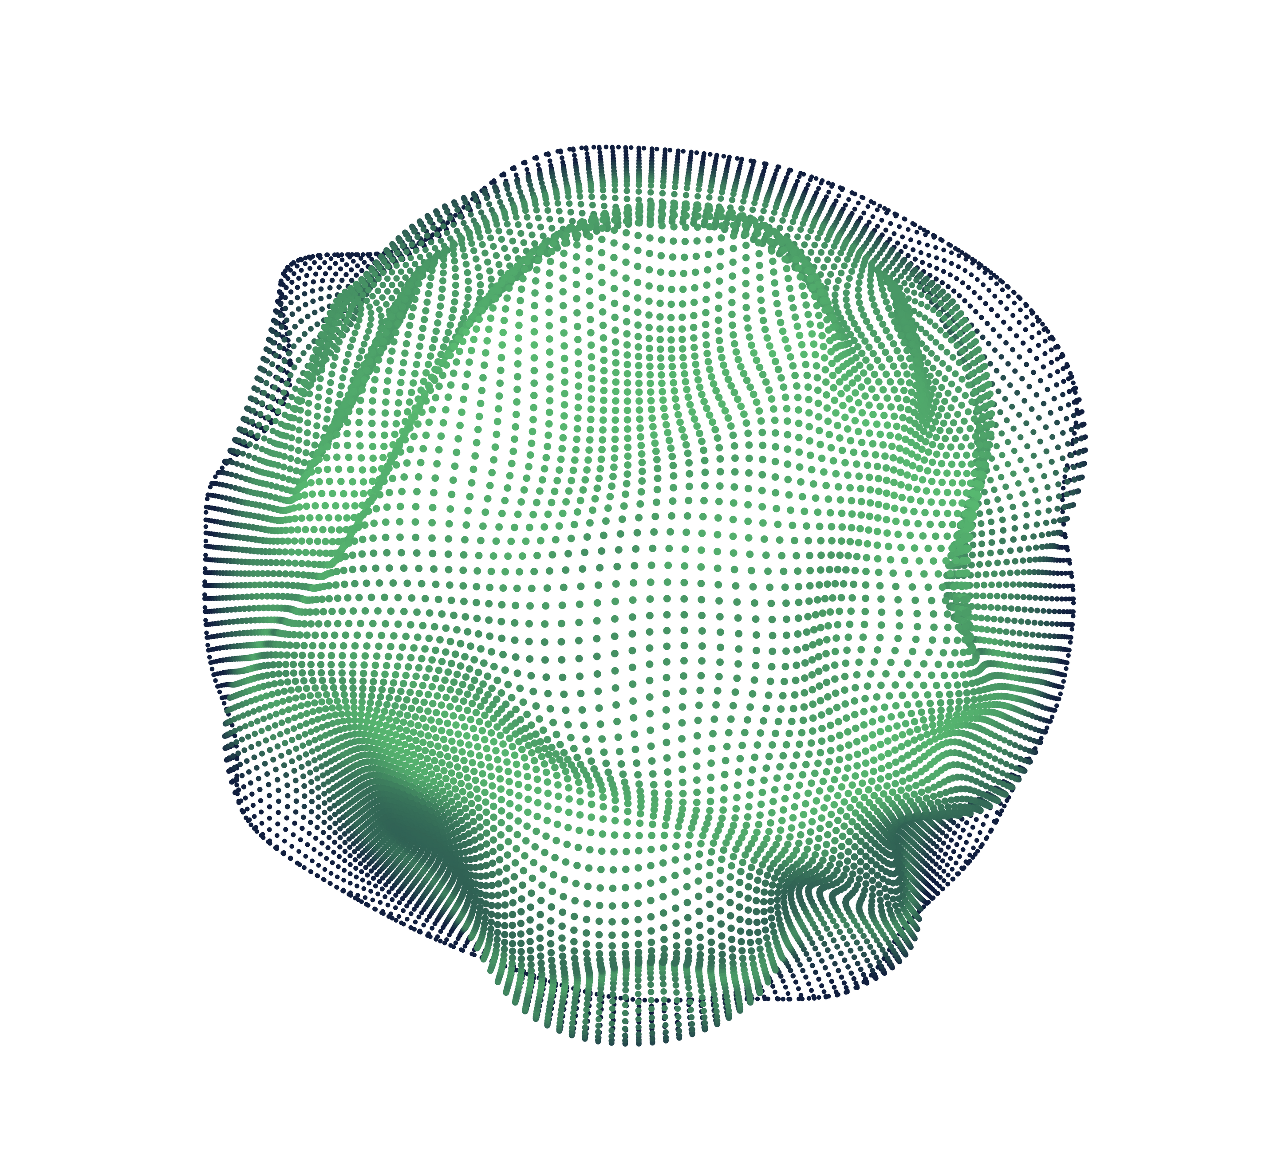

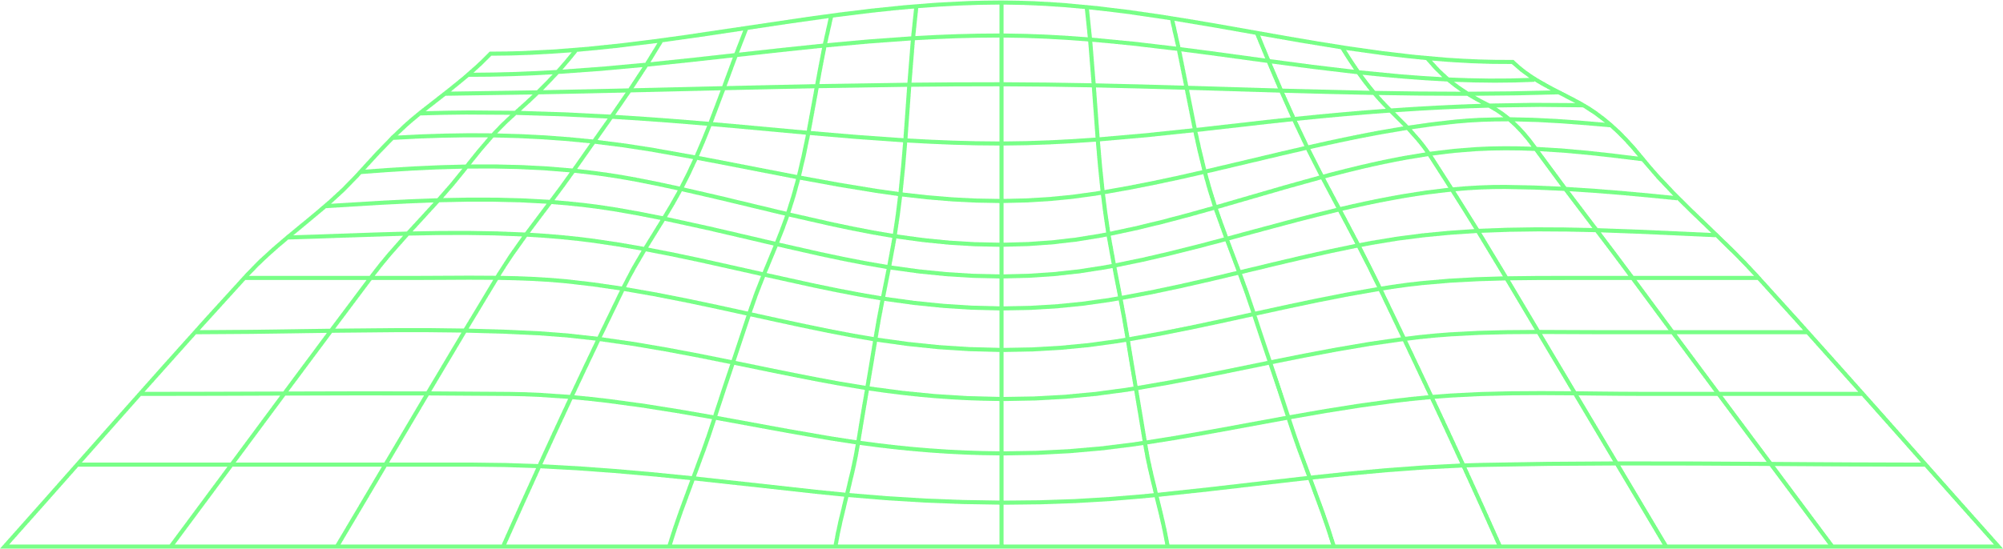
Obstacle Navigation Robot Powered with LLM
Project and Topic Proposal By: Apurva Singh Project Repo Link: github.com/apourva14/obstacledetection-bot

Slide 2

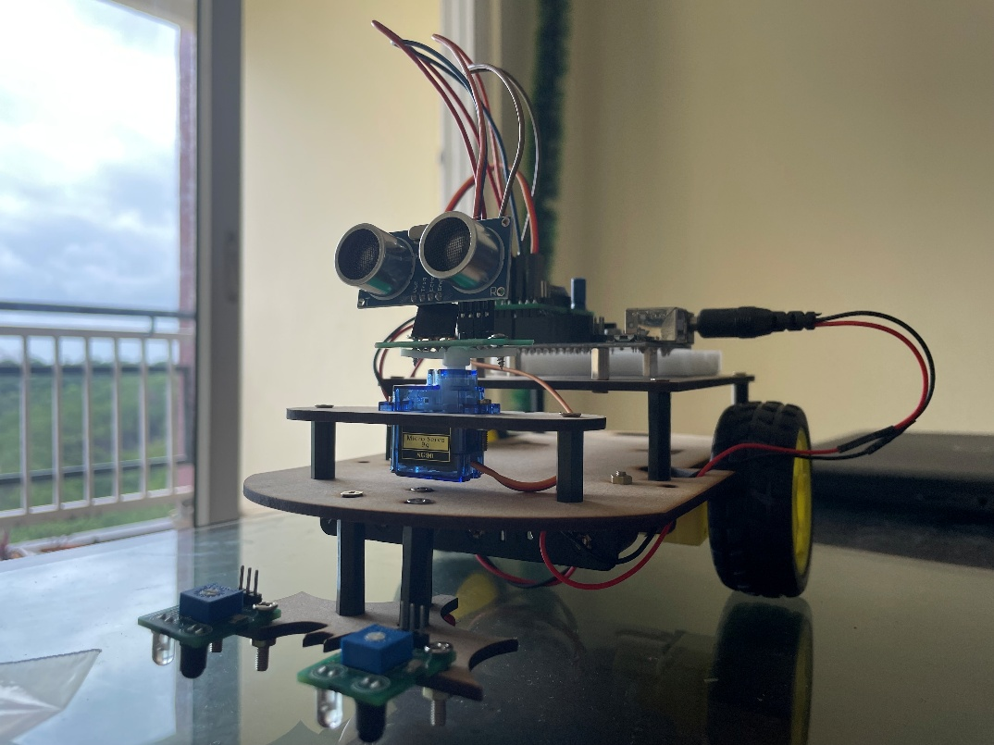
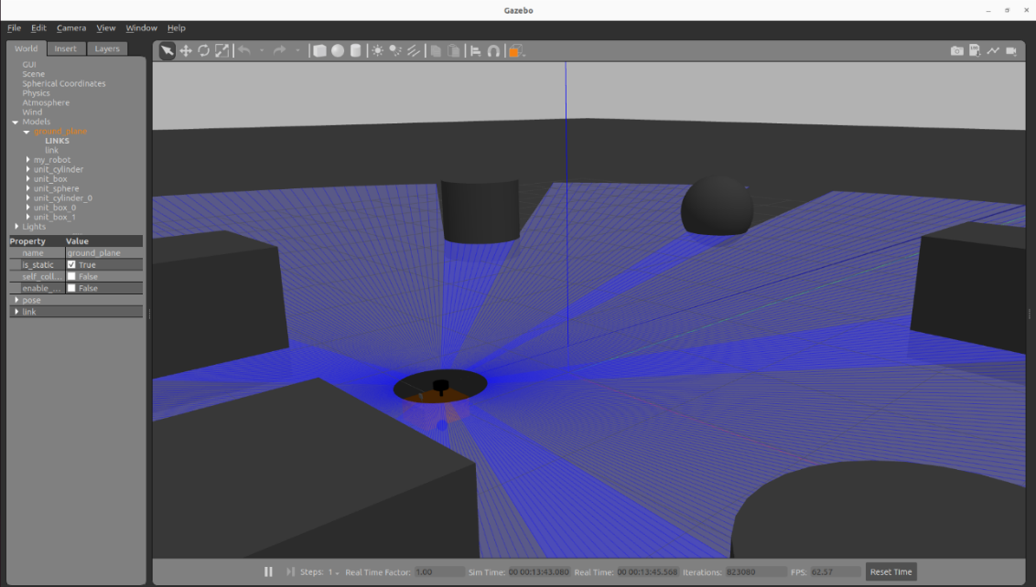
WHAT IS THIS PROJECT ABOUT AND WHAT IT CURRENTLY DOES?
Imagine you have a little robot on wheels that needs to move around without bumping into things or getting lost. This project gives you everything you need—from a “virtual robot” in a computer world to the actual little machine you can build—so you can:
Simulate the Robot in Software
Teach the Robot to Move & Avoid
Visualize What’s Happening
Build the Real Robot Hardware
Seamless Workflow from Virtual to Physical On top of it, as a future enhancement, it is integrated with LLM

Slide 3

POWERING WITH LLM
Integrating an LLM into the Obstacle-Detection-Bot framework opens up whole new avenues for adaptability, transparency, and human-robot collaboration. Here’s how an LLM can slot into each layer of the system:
Instead of hand-coding waypoints or writing custom behavior scripts, you can send simple English instructions. A ROS 2 node would translate that text into a sequence of ROS actions: run SLAM, save the map, set up a patrol loop of Nav2 goals, and subscribe the avoidance node—all without touching Python code.
Tuning PID gains, SLAM thresholds, or sensor filters is normally a trial-and-error slog. An LLM can: Analyze logs or performance metrics and suggest new parameter values.
Real-time Adaptive Behavior

Slide 4


WHY THIS MATTERS
Affordable mobile robots struggle with robust autonomy in dynamic environments.
Traditional rule‑based obstacle avoidance ≈ limited context awareness.
LLMs open avenues for natural‑language instruction, semantic reasoning & safer navigation.
LLM INTEGRATION
LLM for dynamic behavior adaptation
Natural language interface for mission commands
On-the-fly parameter tuning via chat prompts
Zero‑shot reasoning to interpret sensor anomalies & suggest recovery
Few‑shot fine‑tuning on navigation dialogues using open datasets

Slide 5
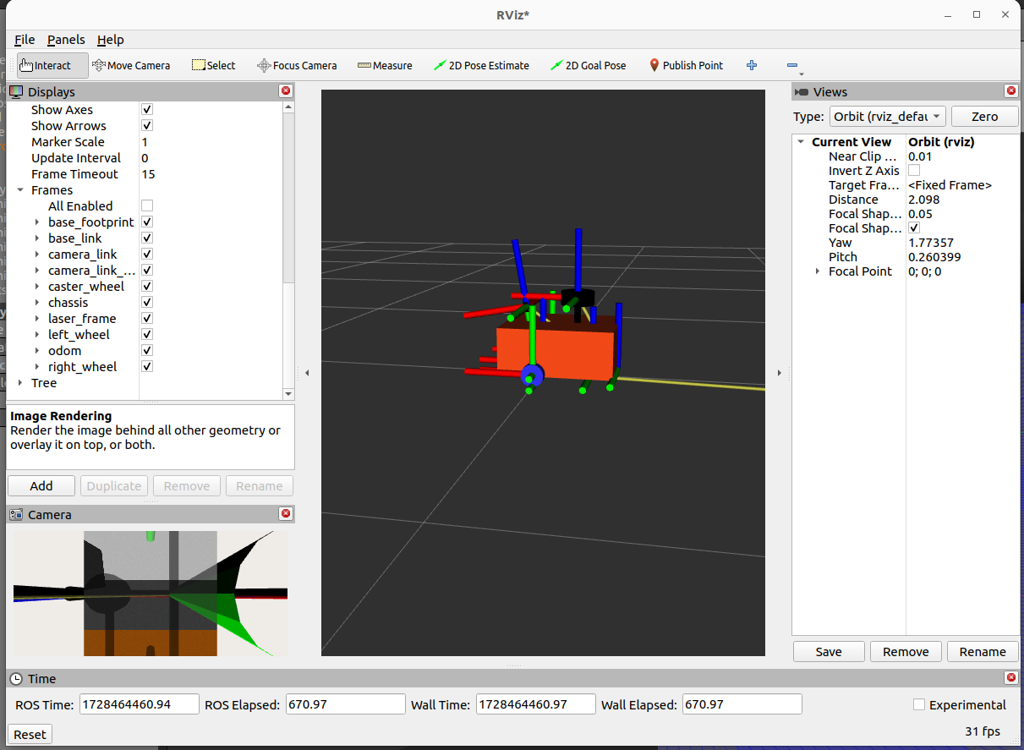
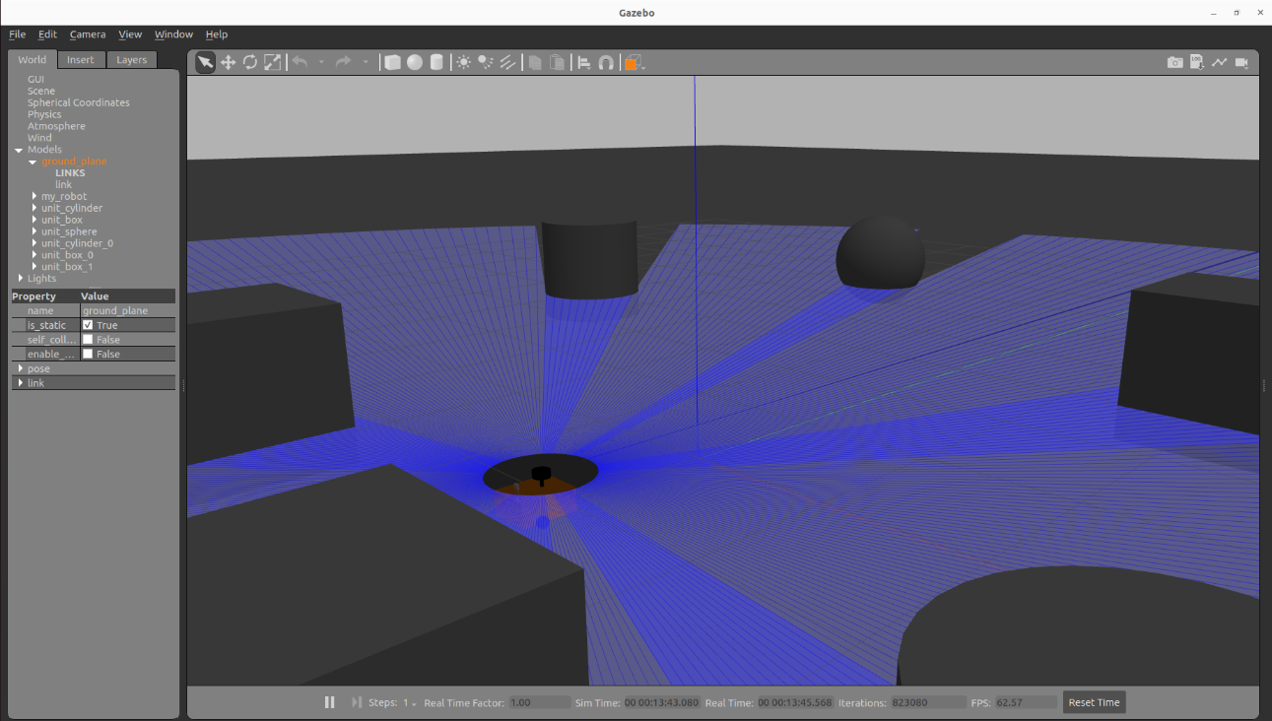
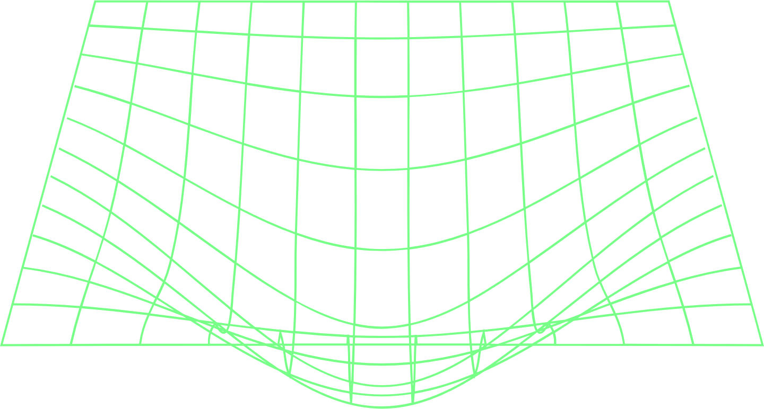
CURRENT VISUALIZATION AND SIMULATION
.
GAZEBO PERSPECTIVE:
Warehouse world with obstacles
Real-time scan rays (blue) and collision checking
Robot chassis and sensor placement
SIMULATION VISUALIZATION
RViz model & TF frames
Laser scan coverage and obstacle mapping
Initial avoidance performance metrics

Slide 6
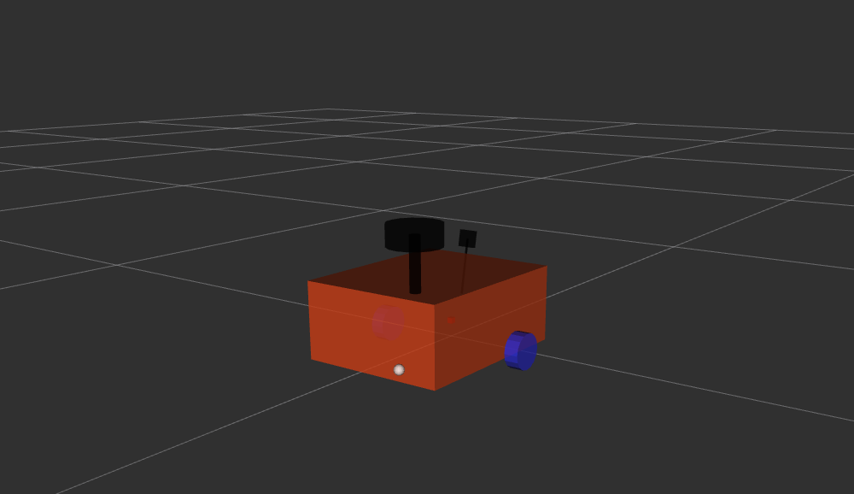
Current Git Repo Snapshot
Hardware Details
Arduino‑based 2‑wheel differential chassis + HC‑SR04 & IR sensors
ROS 2 Humble + Gazebo Classic simulation stack
URDF + RViz visualisation & teleop scripts
Simple reactive obstacle‑avoidance node (Python)
Comprehensive README with WSL2‑Windows workflow
Chassis: Two-wheel differential, micro-caster
Support Controller: Arduino Nano + L293D motor
Driver Power: 6×AA or 7.4 V LiPo with 5 V regulator
Sensors:HC-SR04 ultrasonic (obstacle distance)TCRT5000 IR modules (line-tracking)(Optional) IMU for
Orientation Integration: rosserial/micro-ROS bridge publishes sensors → ROS 2, subscribes to /rav_bot/cmd_vel

Slide 7
Proposed Architecture with LLM:
Perception Nodes (LiDAR/Depth-Cam) → Semantic Segmentation
High-frequency sensor drivers stream raw point-clouds and depth images into a lightweight neural network that labels each pixel/point as “floor,” “wall,” “obstacle,” etc., providing structured scene masks in real time.
Feature Embeddings → LLM (e.g., MiniGPT-4) for Scene Understanding
The segmented outputs are converted into compact embeddings (e.g. via a small transformer head) and sent to the LLM, which fuses spatial layouts with its language priors to recognize objects, infer intent (e.g. “this area is congested”) and answer high-level queries.
Task Planner (Behavior Trees) Driven by LLM Outputs
Based on the LLM’s scene interpretation and suggested goals (e.g. “navigate to clear zone,” “circle around the pillar”), a behavior-tree engine composes and executes hierarchical actions—with built-in fallback nodes—ensuring robust sequencing and reactive safety checks.
Low-Level Control Stays on Microcontroller (Arduino)
All real-time loops (motor PWM, PID for velocity/steering, obstacle distance interrupts) remain on the Arduino, guaranteeing deterministic timing and safety, while high-level setpoints are delivered over ROS 2 without overloading the microcontroller.

Slide 8
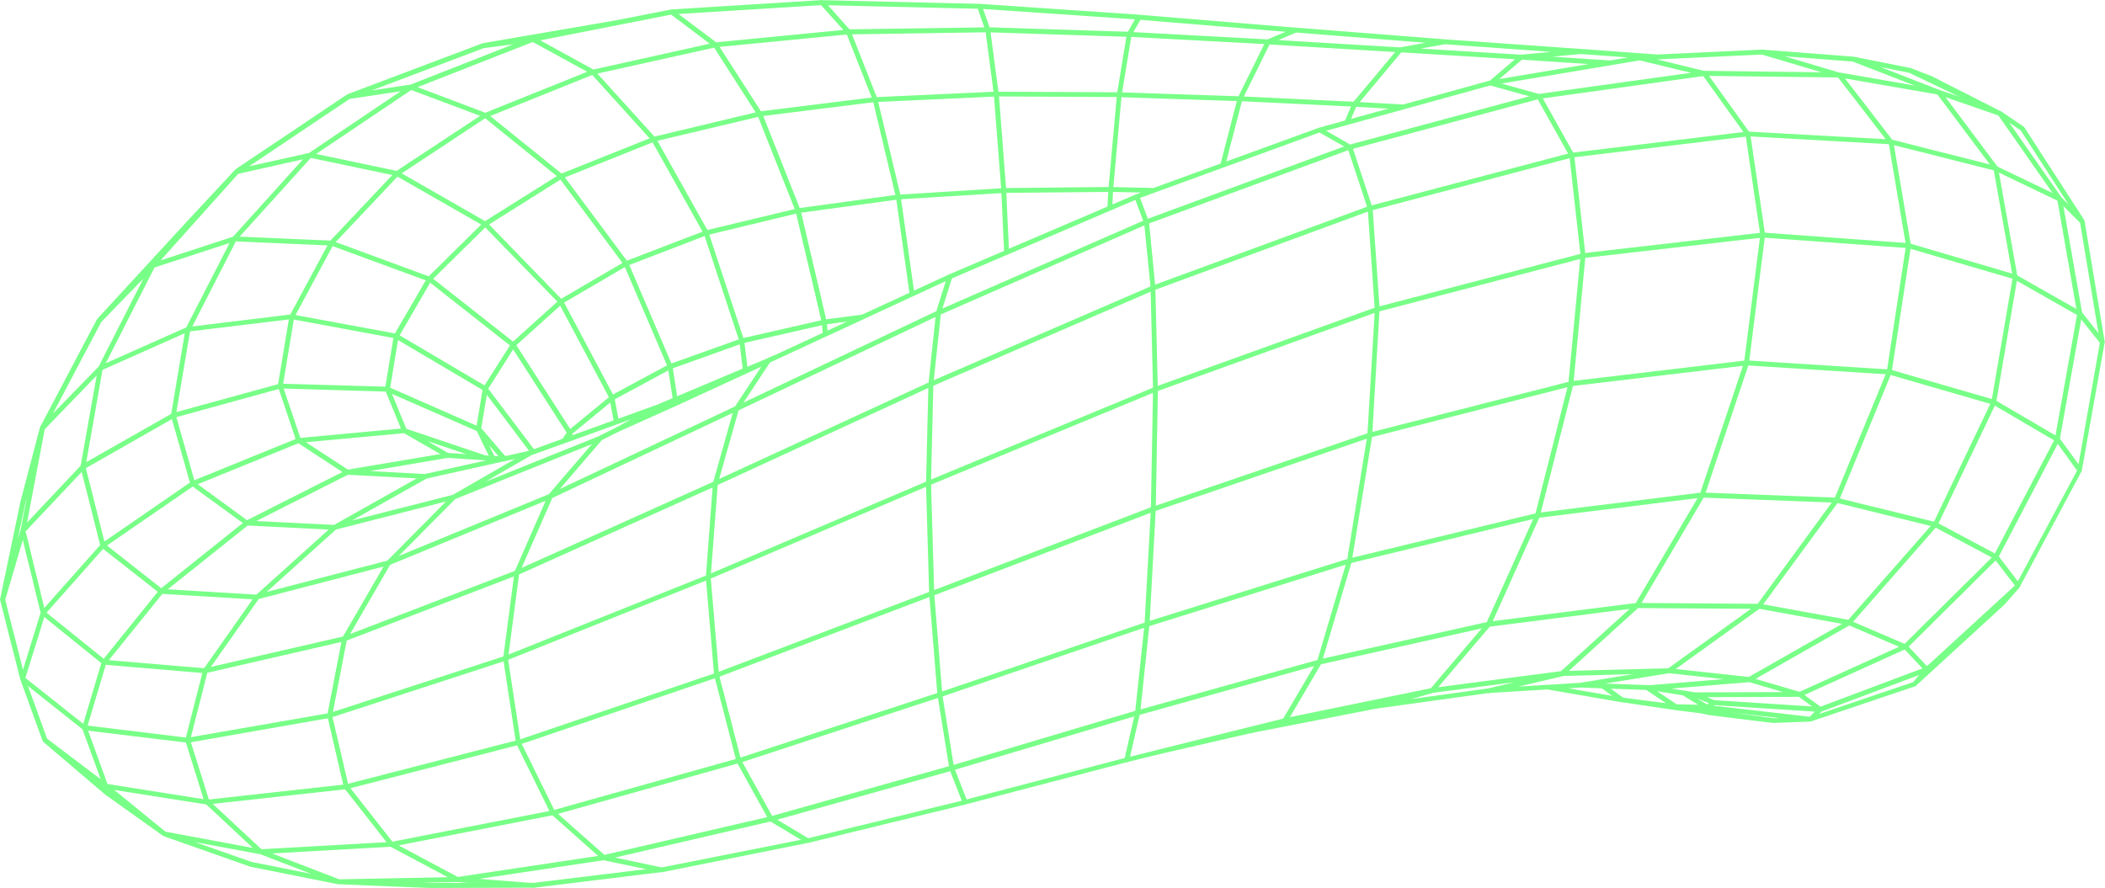
SIMPLE USE CASES AND IMPACT
O
O
1
STEM education kits: students program robots in plain English
2
Hospital service bots: safer navigation in human‑dense corridors
O
O
3
Warehouse inventory scouts: adaptive path planning among pallets
4
Community contribution: open‑source Datasets + ROS packages

Slide 9
















































WHY GHCI’25?
1. Aligned with 2025 theme "AI for Social Good & Innovation"
2. 45‑min Technical Talk + 15‑min Live Demo (Gazebo + Voice control)
3. Hands‑on code lab repo for attendees
4. Encourages women in robotics & open‑source contributions

